Slide 1
WHAT YOU SEE IS WHAT YOU GET
Kaylea M. Boutwell, MD
THE INVISIBLE INJURY
A CONTEMPORARY VIEW OF CONCUSSION
DIAGNOSIS AND TREATMENT
KMB.MD

Slide 2
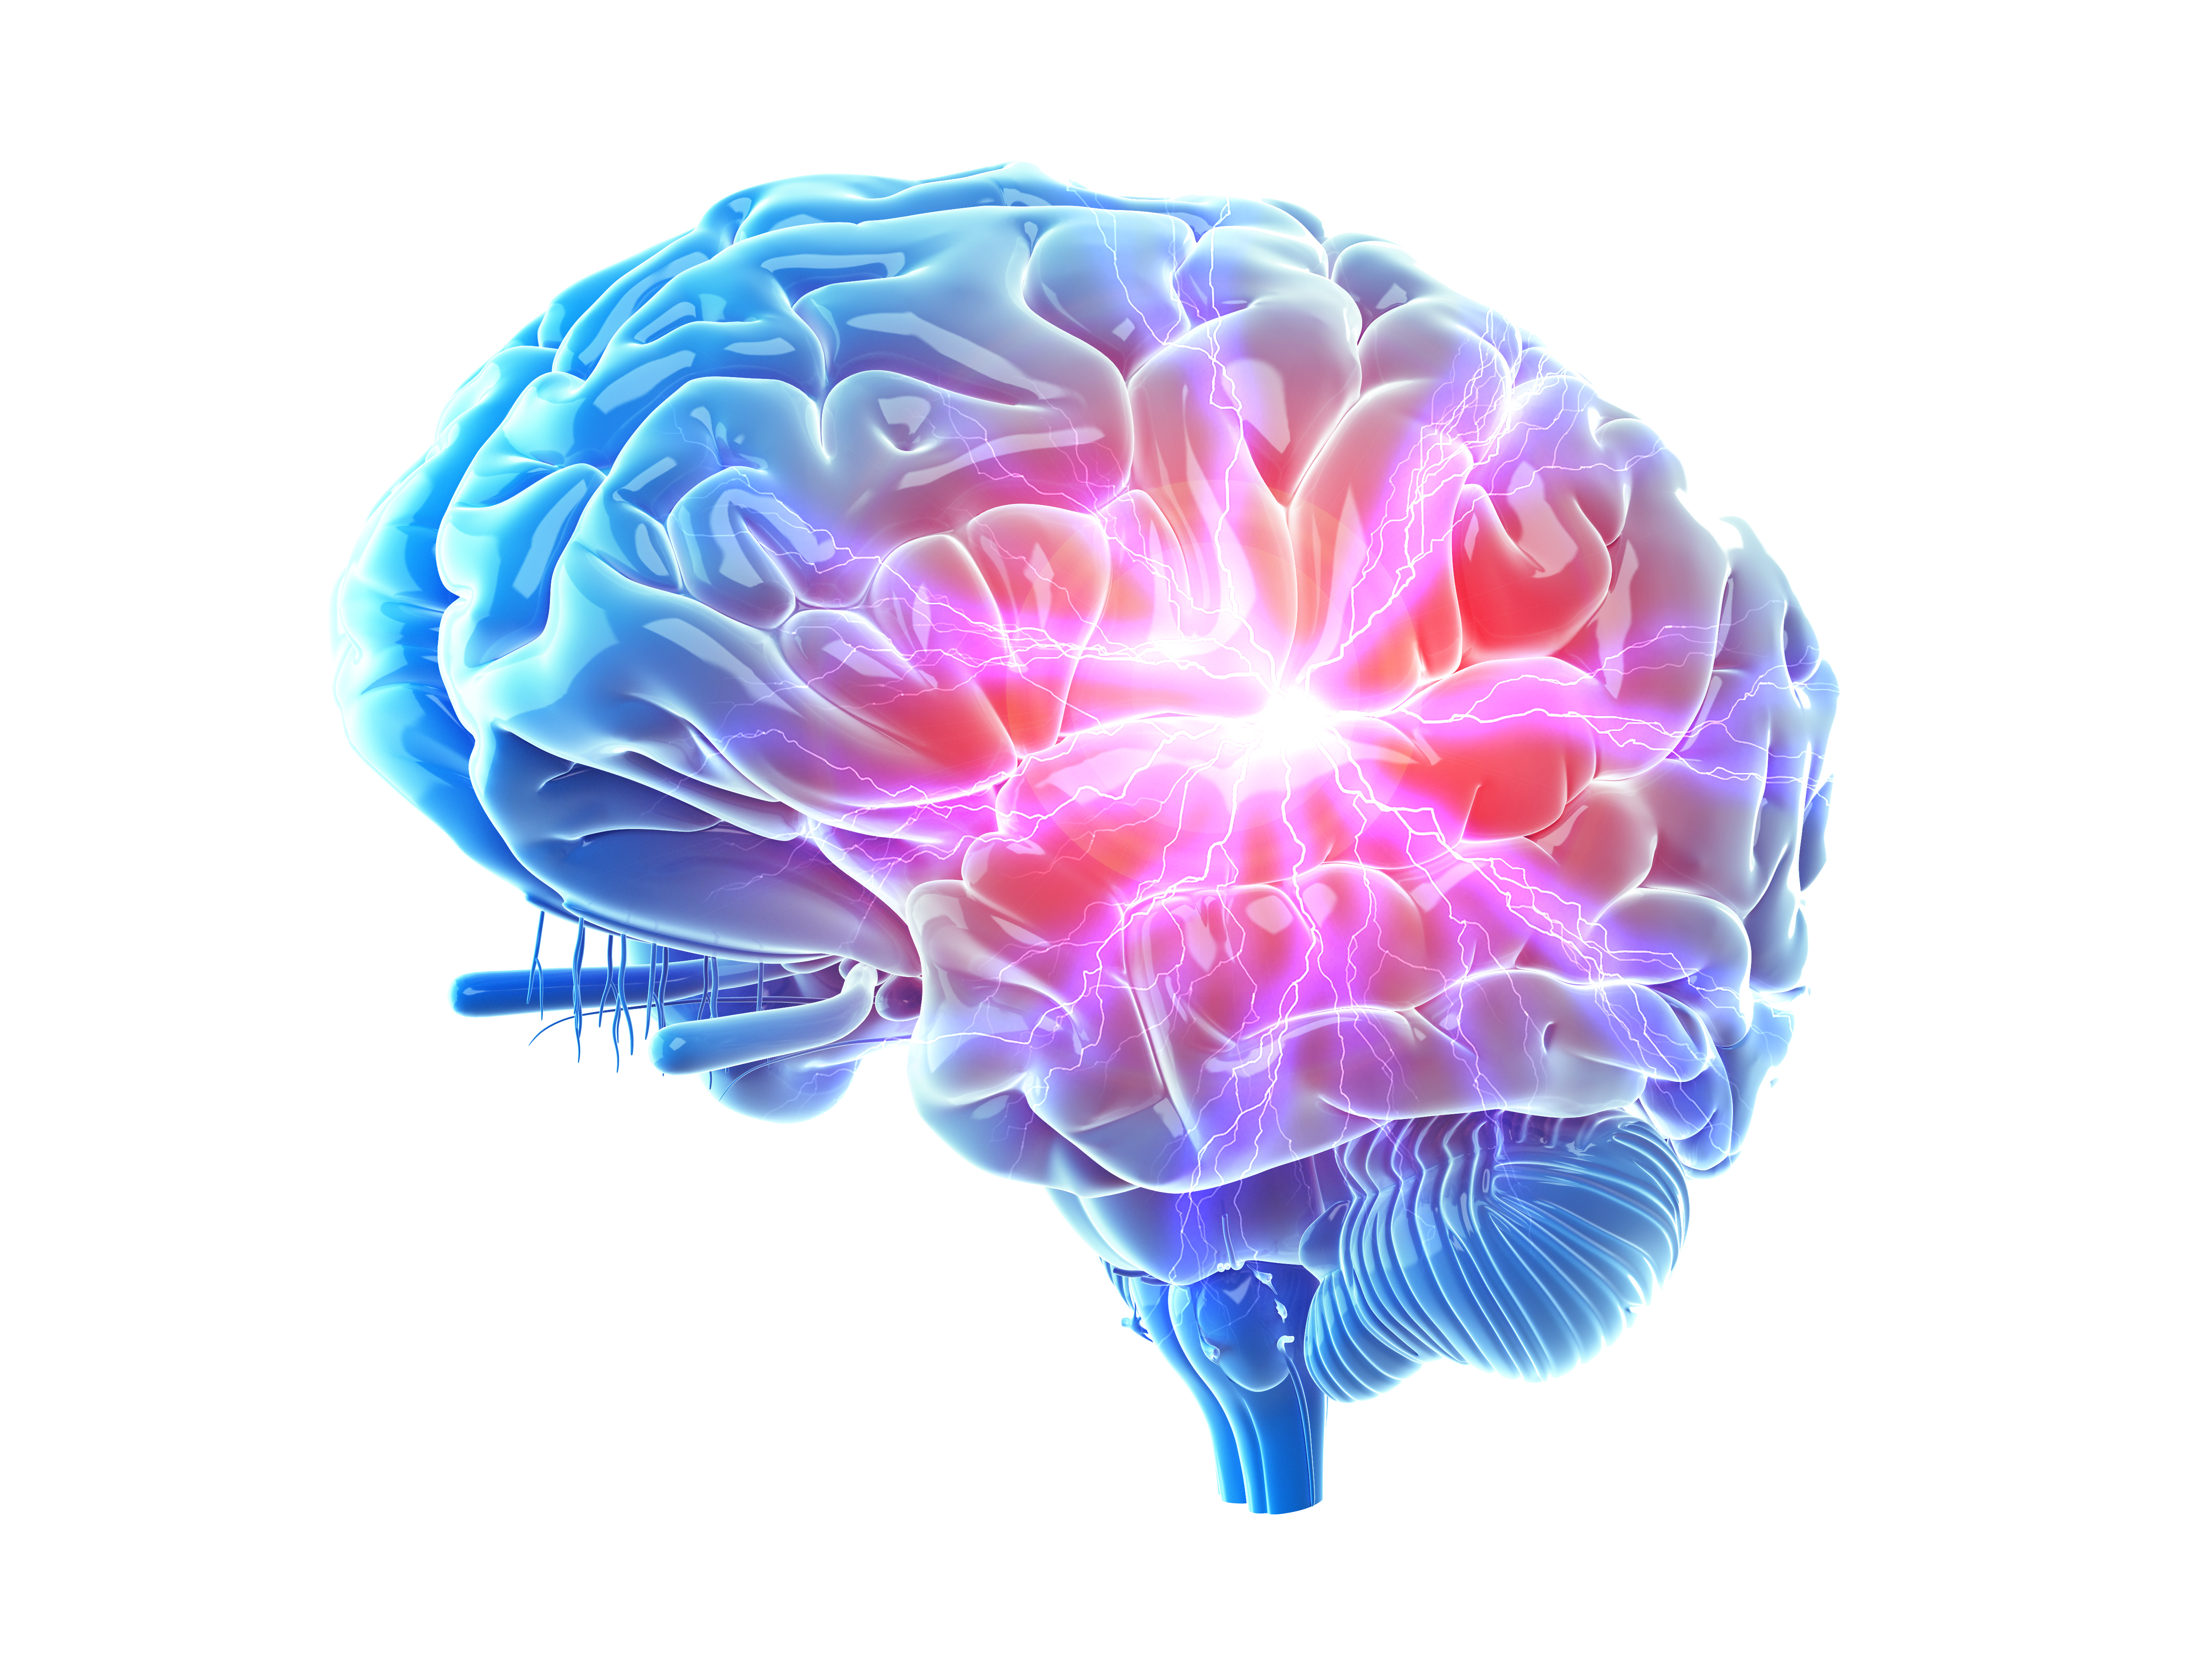
WHAT IS A CONCUSSION AND WHAT IS HAPPENING IN THE BRAIN?
Stretching of neurons, ion exchange imbalance between K+ depolarization, neuronal firing and Glutamate (NT) release
Axons most susceptible. General vs. Specific largely determines clinical characteristics
Results in Ca++ flooding intracellular space, reduces cell’s ability to produce energy by way of mitochondrial dysfunction
Hit – stretch – electrical storm – reduced energy production*
First few weeks is insufficient energy supply for the metabolic/functional energy demand**
* “Neurometabolic Cascade” Vagnozzi, et al 2010
** Day 3, Day 15, Day 21, Day 30 is typically when deficit rebalances

Slide 3
WHAT IS A CONCUSSION AND WHAT IS HAPPENING IN THE BRAIN?
OLD theory: Coup-contrecoup, INJURY to gray matter
Misunderstood pathology
Mis-read constellation of symptoms + signs
Misguided treatment attempts
NEW science: Stretch/Sheer, DISRUPTION of Blood Brain Barrier and neuronal energy supply/demand ratios
Common underlying pathologic process
Constellation of symptoms + signs + formula
Cohesive, collaborative treatment plans

Slide 4
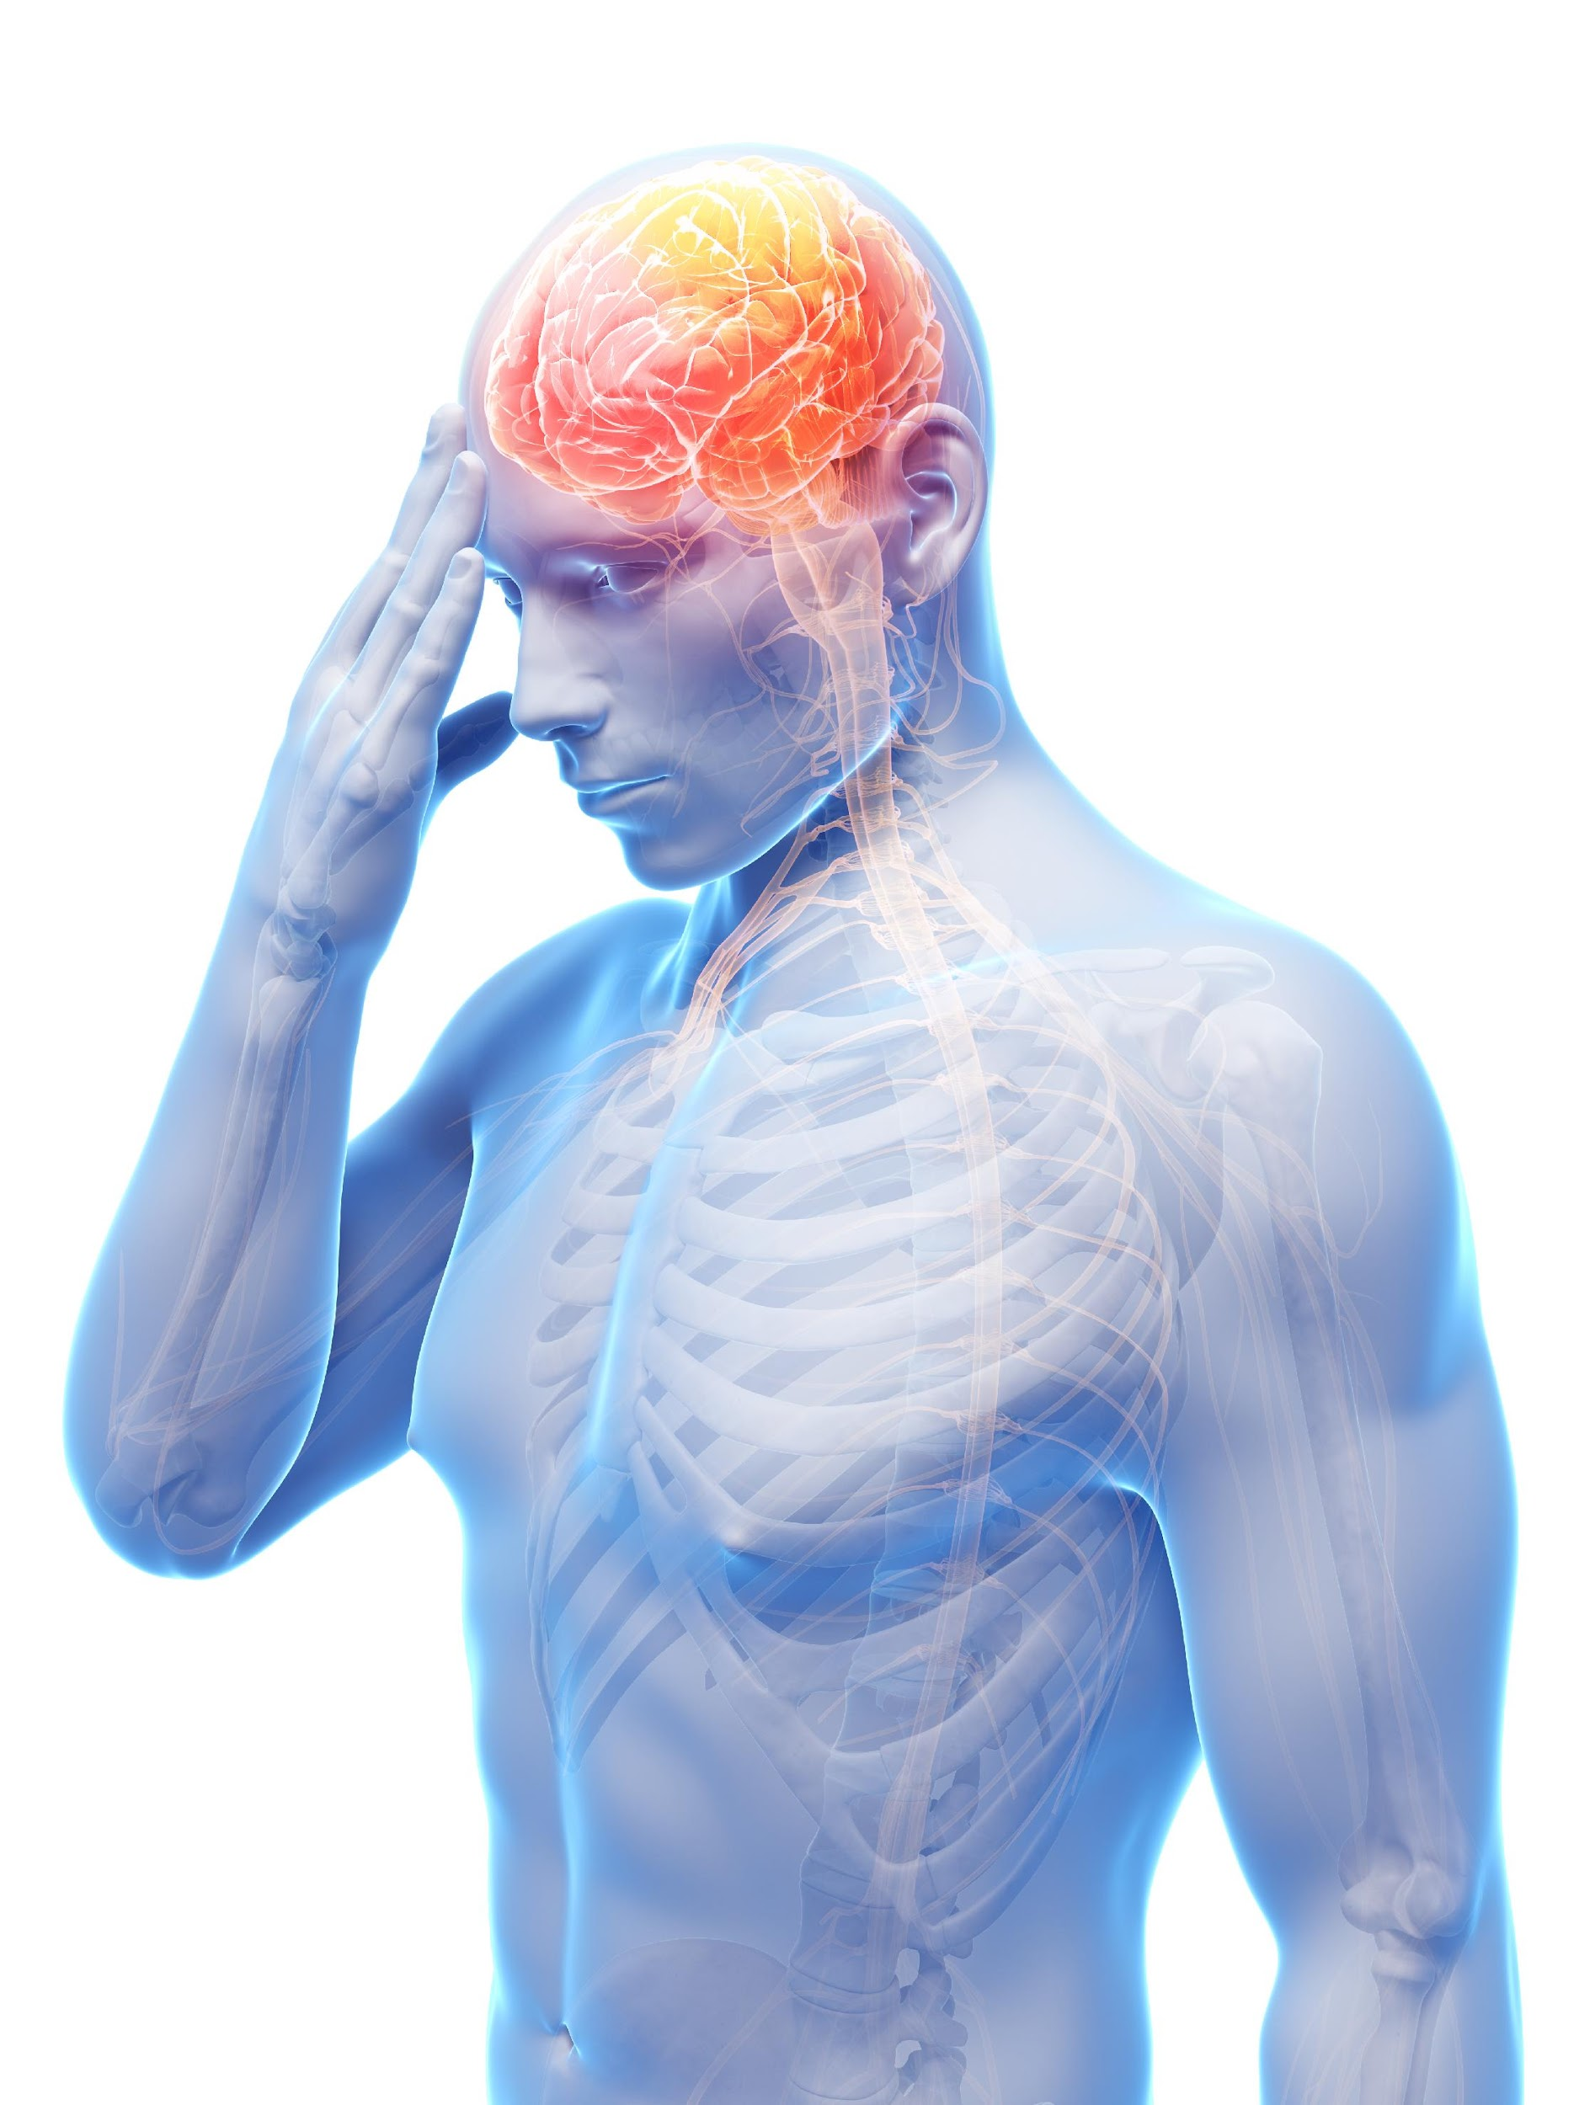
STATISTICS
According to the CDC
TBI – “Is caused by a bump, blow, jolt, or penetrating trauma that disrupts the normal function of the brain.” (Closed or Open)
75% are “Mild” – Synonymous with “Concussion” - mTBI
Examples: Unintentional falls, head strikes, MVA, assault
DOD – “Signature injury of Veterans suffering blast injuries”
CDC – 2.87 MM reported TBI related ED presentations, 1.4MM resulting in hospital admissions
52,000 deaths/year

Slide 5
STATISTICS
ED presentations under-represent incidence, especially of mortality
Brain Injury Association Report – 90% of Reported TBI preventable
Proper working equipment
**Hard Hats, Roll Bars, Safety Education/SOP’s
Seat belts estimated to reduce incidence of TBI by 50% in MVA’s (Head Strike/LOC → Dx??)
SNAPSHOT:
Natasha Richardson
Famous actress/Spouse of Liam Neeson – SDH skiing, death at home 2/2 pressure on brainstem
Unlikely statistically, but devastating to overlook

Slide 6
STATISTICS
Prevention via Education and Proper Protection is Key
Women Tend to be More Symptomatic – Head to Neck Ratio
>325K Americans are living with long term consequences of TBI
Highest Risk > 55 y/o
$76.5B Annual Spend* on TBI Care
In US Alone
(*2010 Data: TBI.com)

Slide 7
THE STATS ARE CONCLUSIVE
Statistics show that proper treatment/prevention of further insult after the SAME physiologic concussion injury can make all the difference
Seamless, steady, sustainable recovery in 30 days or less vs. Indefinitely miserable patient unlikely to ever return to gainful employment
Return to Normalcy and Quality of Life vs. SECOND IMPACT SYNDROME (SIS)
MMI in 4 – 6 weeks with no restrictions vs. Permanent Total Disability on Open Medical*
*Tremendous detriment to the patient, provider and payer

Slide 8
DEFINITIONS AND POSITION STATEMENTS
THE international guidelines for sport-concussion management
NIH consensus format
Meetings every 4 years
2001
2004
2008
2012
2016
2020, 2021
2023
Vienna
Prague
Zurich
Zurich
Berlin
Paris
Amsterdam

Slide 9
DEFINITIONS – TBI MILD, MODERATE, SEVERE
Mild – Most common, “Concussion” / “mTBI” – Brief change in mental state or consciousness
Latest guidelines – No LOC required, or < 30 min LOC, feel asymptomatic/NO amnesia beyond ~24 hours. 20% Reduction in ATP. NOT seen on imaging. GCS 13 – 15.
Moderate – LOC at onset, lasting 30 min – 24 hrs. Alteration of consciousness, possible imaging evidence. Anterograde/retrograde amnesia, 24 hours – 7 days. Headache, confusion, drowsiness, slurred speech. GCS 9 – 12.
Severe - LOC > 24 hours, Amnesia > 7 days, drowsiness, dementia GCS 3 – 8
**GCS important for predictive values relative to recovery

Slide 10
DEFINITIONS – “PCS” → “PSPC”
“PCS”
Post-Concussion Syndrome
“Rest is Best”
Persistent Concussion Symptoms
“Return to Learn”
“PSPC”
Persistent Symptoms Post-Concussion
Symptom Specific Graduated Rehabilitation & Exposure

Slide 11
DEFINITIONS – Persistent Symptoms Post-Concussion
Persistent Symptoms Post-Concussion (PSPC) is defined by symptoms lasting > 30 days
30 – 45% of patients persist when old “watch, wait, rest” methods employed
Early treatment is key to limiting duration and severity of symptoms, and is proven to prevent the majority of conversions to PSPC
After PSPC diagnosed, research shows us that it is only following identification of causes, and initiation of targeted treatment for specific type of PSPC, do patients begin perceptible trend toward recovery of function/healing – i.e. depart the plateau
Can go on indefinitely and thus harder to treat because of underlying and/or developing other issues (VOMS, psychosocial factors, etc.). *Pre-existing vs. Co-Morbid ← → Prevailing Factor

Slide 12
DEFINITION/DISTINCTION – CTE
CTE – Chronic Traumatic Encephalopathy
Progressive neurodegenerative disease associated with repeated concussive and sub-concussive blows to the head. Neurofibrillary tangles and ventricular hypertrophy seen on FDDNP-PET Scans. NOT a continuation of symptoms; typically, 8 – 12 years after last concussion/retirement from sport.

Slide 13
DEFINITIONS – SECOND IMPACT SYNDROME
SECOND IMPACT SYNDROME (SIS)
Perfect storm: “impact” (even quite mild) during recovery phase of prior “impact”
Catastrophic cerebral edema
Controversy → 2nd Impact vs. Larger Impact
Cells with significant energy deficits and/or ROS damage undergo apoptosis and cell death
Uncontrolled inflammation & edema
Mitochondrial changes progressively more pathologic with time between impacts up to 3 days apart; less severe at 4 and 5 days
Day 21 – 30 → Most vulnerable period, regardless of symptoms/severity
****Symptom resolution does NOT correlate with recovery of the brain
Repeat SIS results in perpetually/cumulatively more vulnerable brain tissue

Slide 14
CONCUSSION SUB-TYPES
Autonomic (ANS) Dysregulation – Overstimulation, anxiety, cognitive dysfunction, sleep disturbance; “Five Alarm Fire”
Inflammation of the Nervous System and Hormone System Dysregulation– Brain and Systemic Endocrine Organs - Pain, Immune compromise, Anxiety, Poor response to treatment
Visual and Vestibular – Impaired vision/light processing, nausea, imbalance, vertigo
Cervical Dysfunction* – Overlap with headaches and dizziness
*The most-costly to be overlooked and/or undertreated
Psychological – Social isolation, loss of productivity (financial security, lost work/sense of purpose, secondary gain) – Anxiety, depression, PTSD (MVA, Spousal Abuse), loss of identity/assets (sports, scholarships)

Slide 15
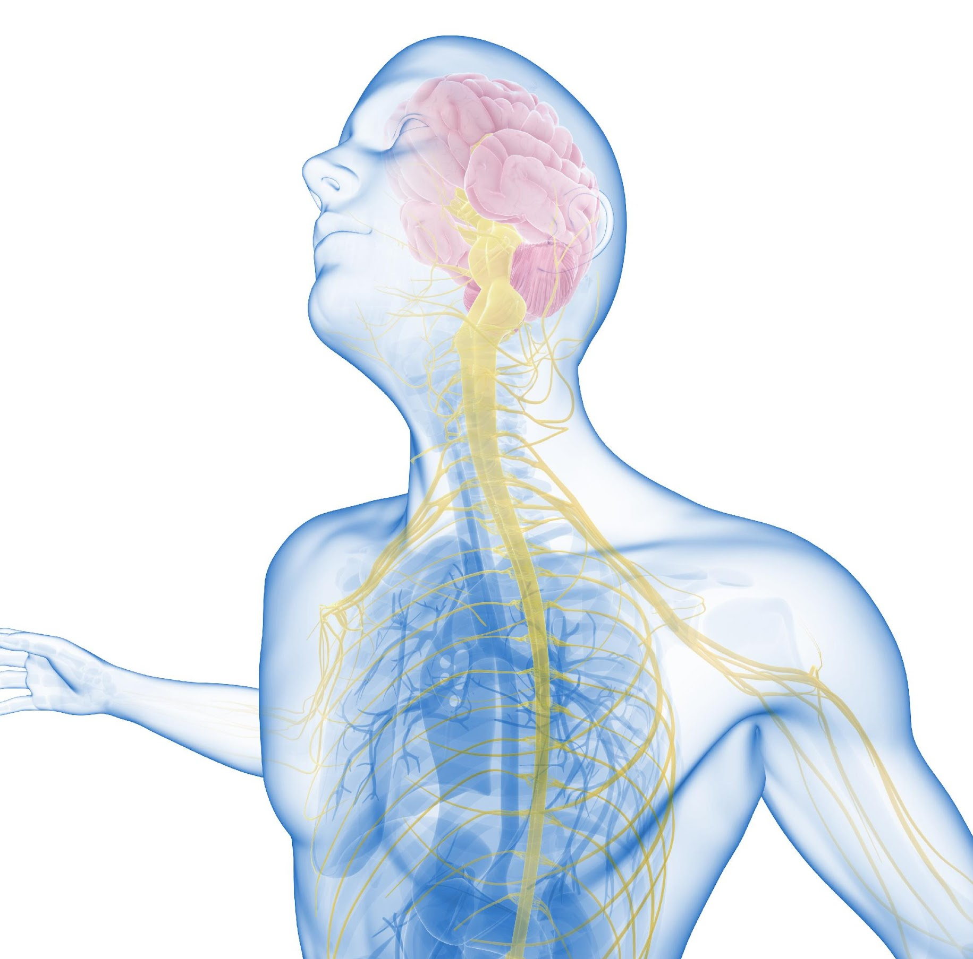
AUTONOMIC DYSREGULATION
PERCEIVED physiologic THREAT in setting of the acute injury EXPLAINS a lot…
Sympathetic → FIGHT or FLIGHT dominance
Visual System - Pupils dilate (TOO BRIGHT!)
Auditory system – Hearing amplified (TOO LOUD!)
Circulatory system – Blood flow upregulates and redistributes blood – Racing heart, bounding pulse, increased blood flow to muscles/periphery, flushing, decreased blood flow to organs
Lack of correlating context → Unpredictable anxiety

Slide 16
AUTONOMIC DYSREGULATION
Sleep Disturbance – Brain/body won’t shut down
Digestive dysfunction, uneasy/queasy feeling, anorexia
Hormone imbalances
Upregulated inflammation
None of this is relevant to the ACTUAL environment… no REAL threat… Exercise intolerant, cognitive/thought process disruption (blood/activity in wrong areas of the brain, parts of brain energy deficient)

Slide 17
AUTONOMIC DYSREGULATION
Key Treatment Facets
Key Providers:
Concussion Quarterback
Physical Therapy with generalized concussion specialization
Ophthalmology/Optometry
Nutritionist/Dietitian
Pain Medicine/Physiatry/Neuropsychiatry

Slide 18
INFLAMMATION/ENDOCRINE DYSFUNCTION
Within 3 hours of a brain injury, the permeability of the gut has already dramatically increased. Proteins, chemicals, etc., meant to stay in or out of the gut now cross in unregulated, unhealthy directions across the gut lining → Leaky Gut
incites immune & inflammatory responses
Brain fog, headaches
Makes nutrition, sleep hygiene and stress regulation a KEY aspect of managing concussion
Adrenal function – Cortisol
Good news!! Each of these treatable with repair/restoration of proper gut barrier function.

Slide 19
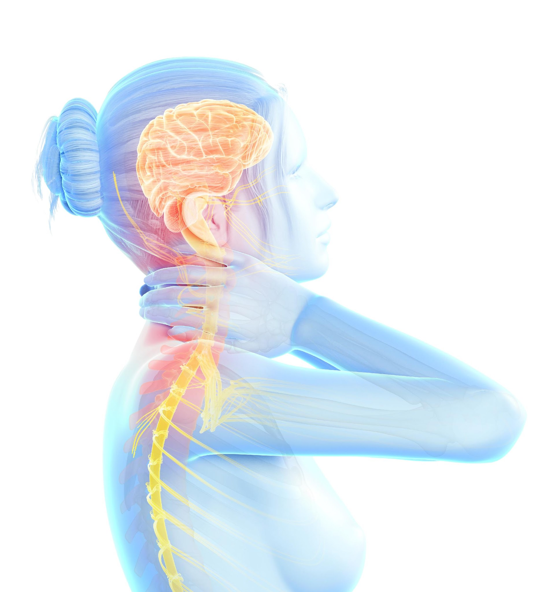
INFLAMMATORY/ENDOCRINE DYSFUNCTION
Key Treatment Facets
Key Providers:
Concussion Quarterback
Physical Therapy with concussion rehabilitation specialization
Nutritionist/Dietitian
Endocrinologist
Interventional Pain Medicine/Physiatry

Slide 20
VISUAL AND VESTIBULAR
Proprioceptive De-Coupling (NECK also participates in proprioception)
Motion Sensitivity, Sensitivity to Lights
Spinning, Nausea, Vertigo
If cumulative inputs are not telling your brain the same things, resulting sense of imbalance, wavy, dysphoria, motion sickness, spatial confusion..
Brain is like, “wait a minute, who do I believe here”… sufficiently important that the brain will try and shut down (or further amplify) activity until if feels secure that its information is correct.

Slide 21
VISUAL AND VESTIBULAR
Key Treatment Facets
Key Providers:
Concussion Quarterback
Physical Therapy with Vestibular Rehabilitation Specialization
Ophthalmology/Optometry/Neuro-ophthalmology
Nutritionist/Dietitian
Interventional Pain Medicine/Physiatry

Slide 22
CERVICAL DYSFUNCTION
CONCUSSION VS WHIPLASH: SYMPTOMS are IDENTICAL
BOTH: H/A, Dizziness and Imbalance, Cognitive disturbance, Memory/Concentration Impairment, Visual Disturbance, Fatigue, Psychological Distress
THEREFORE, differences are KEY…. Whiplash Suspected with Arm Pain, Limb Paresthesia, TMJ Dysfunction
Concussion More Likely to Feature Nausea
CONCUSSION TAKES 70G – 120G TO OCCUR **WHIPLASH: Only takes 4.5G force to occur…. SO – Can have whiplash w/o concussion, can not have concussion without whiplash (Easy to remember logically, important to note clinically)

Slide 23
CERVICAL DYSFUNCTION
Common cause of “PSPC” Is actually *isolated* cervical or other pathology
Proper evaluation & order of operations – PT, Pain Management, Sports Medicine
Proper treatments – Don’t waste time/money doing things not likely to work, or NOT doing things likely to work! (…Note how rest and do nothing is STILL not on this list?)

Slide 24
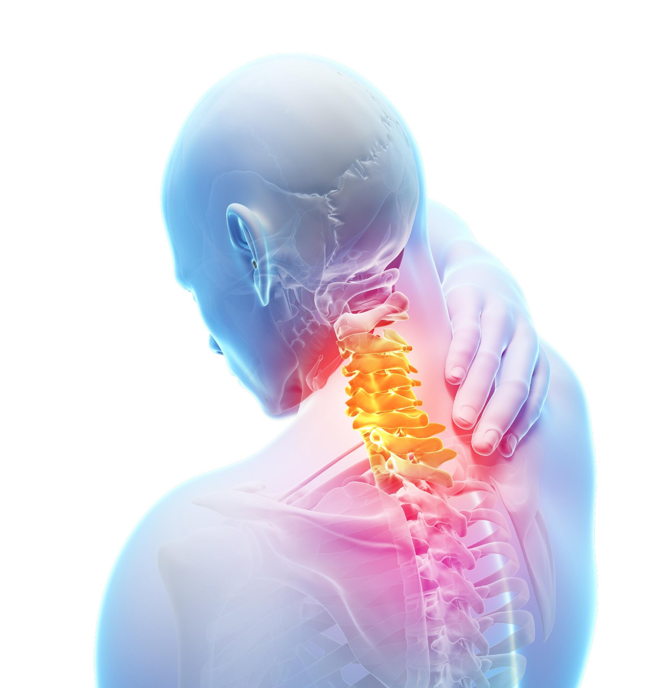
CERVICAL DYSFUNCTION
Key Treatment Facets
Key providers:
Concussion Quarterback
Physical Therapy with Spine MSK Specialization
Interventional Pain Medicine/Physiatry

Slide 25
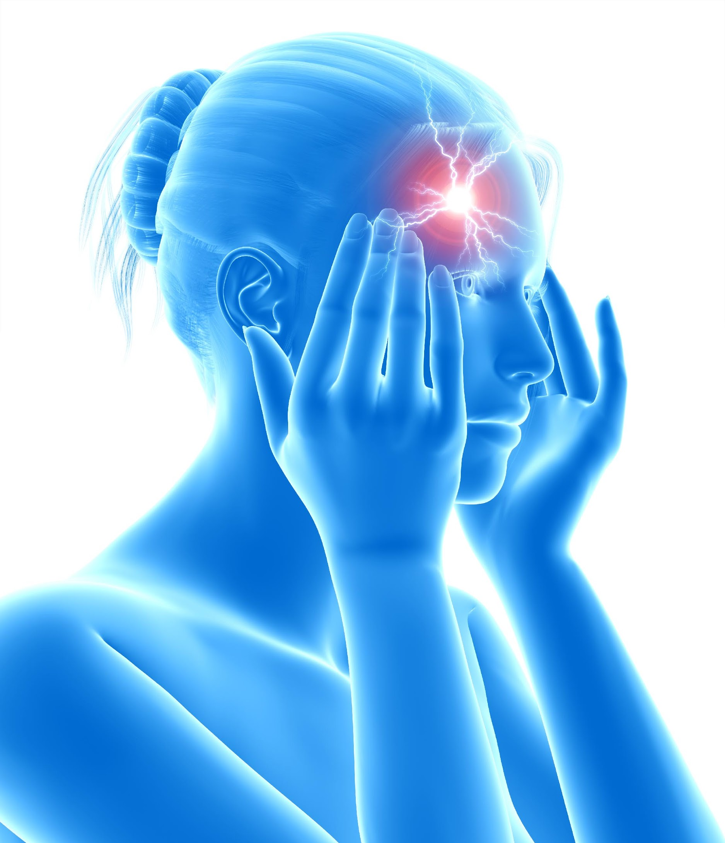
PSYCHOLOGICAL
Default Mode Interference – More of your internal/primal dialogue over-drive (also seen in mania, chronic anxiety, hyper-perseverance, pre-occupation with not being able to think/process properly
Executive Network – Thinking about what you’re doing, planning, etc.

Slide 26
PSYCHOLOGICAL
Key Treatment Facets
Key providers:
Concussion Quarterback
Physical Therapy with generalized concussion specialization
Psychology/Psychiatry/Neuro-Psychiatry
Counseling
Pain Medicine/Physiatry

Slide 27
THE INVISIBLE INJURY
This “invisible” injury can clearly cause tremendous harm and disruption in patients work, lives and sense of well-being, but not so clearly that it presents itself as obvious or easily identifiable…
Anyone who has ever dealt with (or known someone dealing with) a concussion or more severe TBI knows the feelings of helplessness that can be associated with the suffering that has no outwardly visible signs of harm…
Anyone dealing with a concussion patient as a CLAIMANT knows the feeling of frustration associated with being responsible for an “injury” that seemingly has no reliable “evidence” to prove presence, absence nor “recovery”….
SO HOW DO WE SEE IT?

Slide 28
THE CHALLENGES
Highly Variable Mechanisms of Injury
No Supportive Imaging
No Standardized Blood Testing Panels
Highly Variable Presentation of Injury
All of These then Leading to Increased Level of Challenges in Diagnosis and Treatment → Invariable Questions of Malingering or Secondary Gain → Lack of Support → Poor Outcome →…

Slide 29
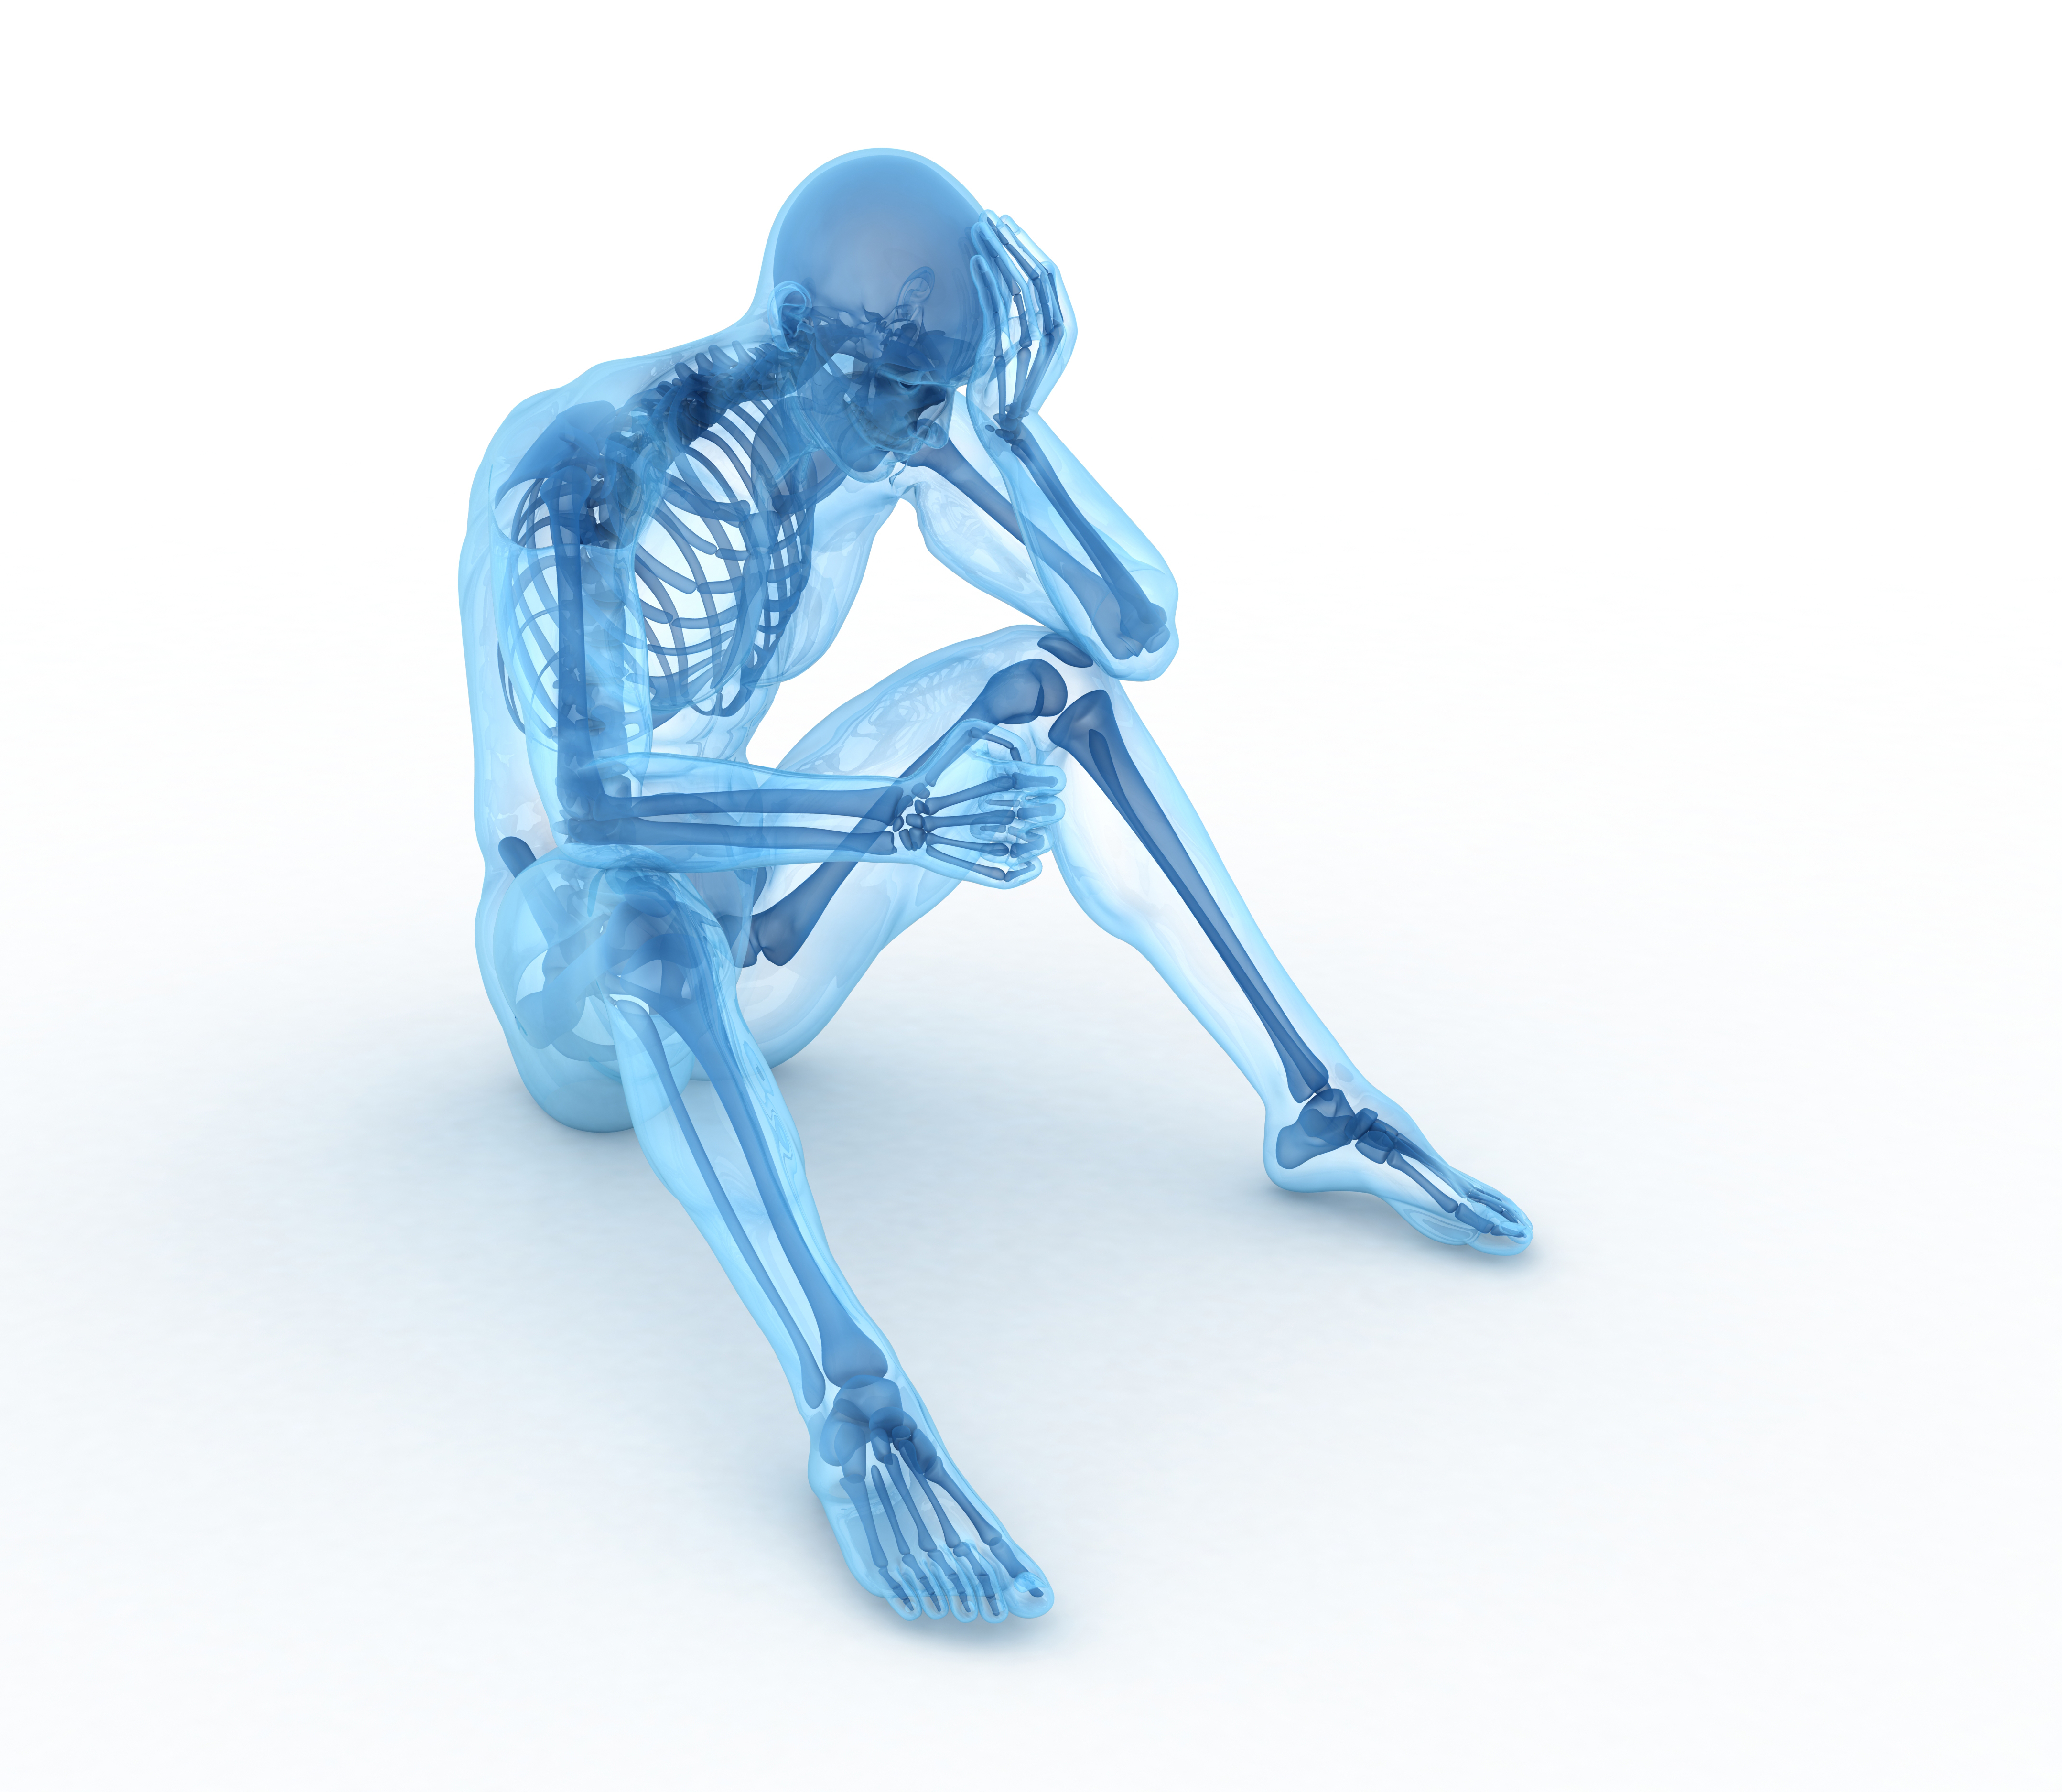
ISOLATION IS NOT THE ANSWER
Rest, social isolation, lost income/productivity makes many individuals depressed and anxious
Concussion pathophysiology also commonly results in patient complaining of being depressed and anxious
Mandating extremes of rest/social isolation, etc. to treat concussion compounds the issue, as opposed to helping resolve it, especially in patients with certain pre-existing personality or lifestyle traits

Slide 30
AND MAY LEAD TO…
Confusion of feelings vs. symptoms, making it difficult to know which is which – and whether or not you are making progress
Anxiety or guilt, with some patients feeling/stating they feel like the provider thinks the problem is “all in their head” (figuratively, not literally)
Reaction to unconscious triggers or cues that create swings in mood (the classic “Gas and Brake” analogy)

Slide 31
CONSIDERATIONS
Thus, anxiety, depression, etc., serve as barriers to recovery, and can mimic concussion symptoms
Target for treatment? Psychiatric care involvement?
At a minimum, we must minimize factors that contribute to depression/anxiety, especially in those with pre-existing psychiatric conditions
To miss this decelerates recovery, amplifies symptoms and lengthens recovery times; a primary factor in probability of full recovery

Slide 32
CONSIDERATIONS
Concussion is NOT long-term brain damage
Rather, It is a multi-faceted, temporary and recoverable brain energy imbalance
MRI, CT, etc. shows no structural damage
This is also what separates Concussion from more severe forms of Traumatic Brain Injury, Stroke, etc.
These more severe conditions should be managed by a Neurological specialist trained specifically in the management of those conditions
Science is, by its very nature and focus: SLOW
It takes a decade or more for academic research to come into mainstream paradigms
2010 marked the beginning of the bench research here
So we are (in a sense) on-track

Slide 33
THE SOLUTION
RESPONSIVE
Early assessment, active engagement and patient education
Impart optimism and instill belief in probability of recovery
Can be the largest “delta” in good vs. poor outcome
ATTENTIVE
Comprehensive evaluation including full history – PMHx, Details of Injury, SHx
Set scheduled “Quarterback” appointments Q2 weeks up to 8 weeks
INFORMED
Understand the unique nature of Concussion as a Pathophysiology
Declares itself early – Define “category” and/or “combinations”
Generally FAVORABLE prognosis when properly categorized and accordingly treated
Multi-Disciplinary/Team approach treatment is nearly constitutionally required
Know that these patients need to feel SEEN to embrace the process of recovery

Slide 34
SYMPTOM SPECIFIC TREATMENTS
Simple, but not easy…
Creating the “Narrative”
True for both patient and provider(s)
Patient:
Dramatic? Malingering? Secondary Gain?
Provider:
Buying in? Seeing all the obstacles and opportunities?

Slide 35
SYMPTOM SPECIFIC TREATMENTS
OLD TREATMENTS MAKE THINGS WORSE….
BUT SO DO NEW TREATMENTS… HUH?
Take it easy and rest…. Bad on the one hand
Get out there and push yourself…. Bad on the Other
VS
So, which is it? Like most things, it depends!
Proper diagnosis is paramount for execution of team-approach treatment
Exercise and stimulation to tolerance and re-conditioning is key in ALL forms of TBI

Slide 36
DIAGNOSTIC TOOLS
CT
(Not the tool we wish it could/would be…)
ImPACT
VOMS – BESS
SCAT6
DANA
GCS
Notes:
ImPACT – Immediate Post-concussive Assessment and Cognitive Testing – 20 = 30 minute computer based test helps measure aspects of cognitive function, ie, attention span, working memory, sustained and selective attention span.
SCAT5 – 13y/o and older; Scoring includes: Red Flags, Memory Assessment/Maddocks Q’s, GCS, Cervical Spine Assessment, Sx Evaluation, Cognitive Screening, Balance Examination, Delayed Recall
DANA – Psychological testing, “The Brain Thermometer” – FDA cleared suite of cognitive and psych assessments for subtle and acute changes in cognitive resilience and speed.
VOMS – Vestibular/Ocular-Motor Screening – Designed at UPMC to eval the systems in charge of integrating balance, vision, and movement, only requires a tape measure and metronome
BESS – Outcome measure of postural stability/deficits; scores increase with age and ankle instability. Hands off the iliac creates, opens eyes, stumbles/flexes at the hip >30 degrees, lifting forefoot. 20 second trials

Slide 37
CASE STUDY
MIS-DIAGNOSIS
OF CONCUSSION

Slide 38
CASE STUDY
“WHAT YOU SEE IS WHAT YOU GET”

Slide 39
PEARLS FOR THE AUDIENCE
*Concussion patients can have great outcomes… with early assessment, accurate categorization and effective, active management.
*Think of your concussion patients like you would your favorite friend or relative - be responsive, be attentive, be informed.
*Think both broadly and specifically about what you are seeing:
the how, the why and the who.
*Remember that concussion “plays dirty.”
POST CONCUSSION SYNDROME
PERSISTENT CONCUSSION SYMPTOMS
PERSISTENT SYMPTOMS POST-CONCUSSION
VS
VS

Slide 40
ACKNOWLEDGEMENTS

Slide 41
Thank You
Phone: (314) 230-7800
E-mail: careteam@katalystmd.com
katalystmd.com/about/

